Slide 1
MDTS4214: Predictive Analysis
Predictive Analytics in the Global AI Job Market
Modeling Salary Trends, Classifications, and Feature Importance
Saurabh Mishra
MSc Data Science, Sem 2
St. Xavier's College

Slide 2
Project Objective
The objective of this project is to analyze an AI job dataset and build predictive models for:
Predicting salary using regression techniques
Predicting whether a job is fully remote using classification techniques
Identifying influential factors affecting salary and remote work
Detecting multicollinearity, influential observations, and interaction effects
Comparing multiple machine learning and statistical models

Slide 3
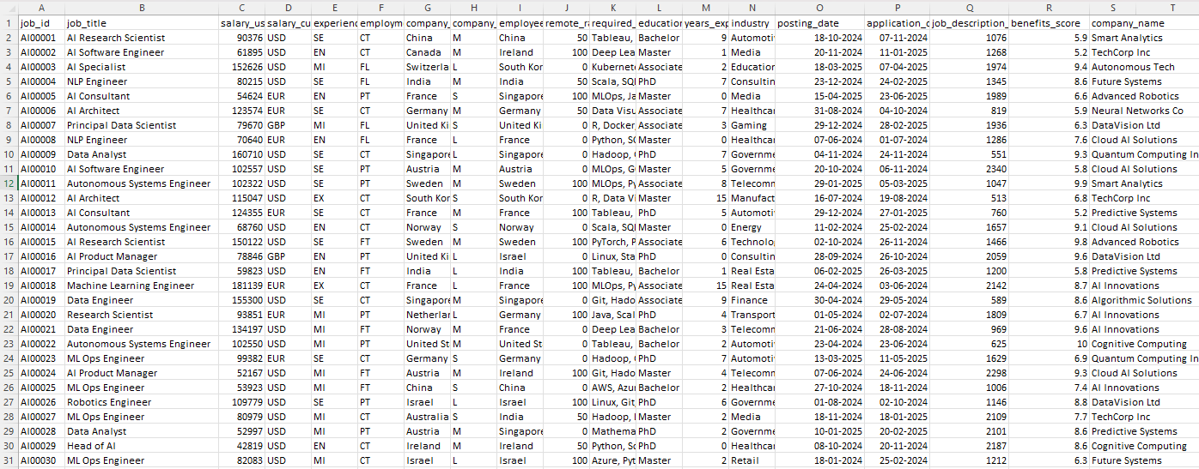
Overview of dataSET

Slide 4
Global AI Job Market & Salary Trends 2025 A Comprehensive Analysis of Global Employment Trends in AI Synthetically
Dataset Overview:
This comprehensive dataset contains detailed information about AI and machine learning job positions, salaries, and market trends across different countries, experience levels, and company sizes. Perfect for data science enthusiasts, career researchers, and market analysts for practice purposes.
What's Inside:
It includes detailed salary information, job requirements, company insights, and geographic trends.
Key Features:
15,000+ job listings from 50+ countries
Salary data in multiple currencies (normalized to USD)
Experience level categorization (Entry, Mid, Senior, Executive)
Company size impact analysis
Remote work trends and patterns
Skills demand analysis
Geographic salary variations
Time-series data showing market evolution

Slide 5
Dataset Description
The dataset contains information about AI-related jobs.
Main variables used in the analysis:
salary_usd: Annual salary in USD
years_experience: Number of years of experience
benefits_score: Score representing employee benefits
experience_level: Level of experience
education_required: Minimum education requirement
company_size: Size of the company
remote_ratio: Percentage of remote work
Justification
These variables were selected because they are expected to influence salary and remote work opportunities.

Slide 6
Data Preprocessing
Content
Steps performed before modeling:
Removed missing values using dropna()
Selected only relevant variables
Created a binary variable is_remote:
1 = Fully remote job
0 = Not fully remote
Converted categorical variables into dummy variables
Split the data into training set (80%) and test set (20%)
Standardized predictors using StandardScaler()
Justification
Preprocessing ensures the data is clean, numerical, and suitable for machine learning algorithms.

Slide 7
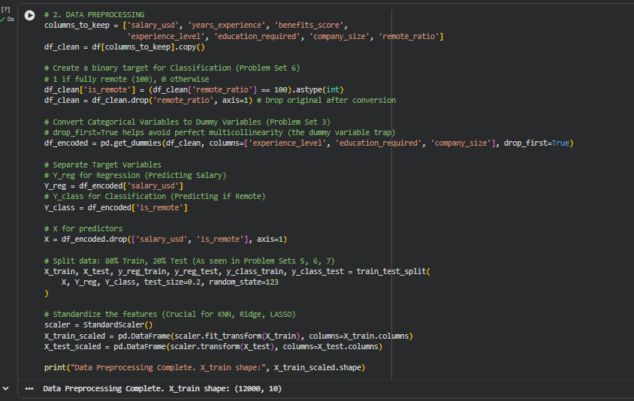

Slide 8
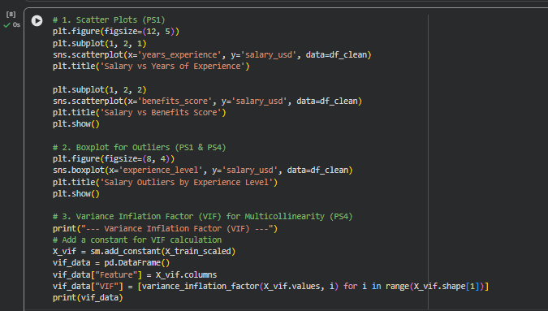
Exploratory Data Analysis
Content
The following visualizations were created:
Scatter plot of salary vs years of experience
Scatter plot of salary vs benefits score
Boxplot of salary by experience level
Observations
Salary generally increases with years of experience
Higher benefits scores tend to be associated with higher salaries
Salary distributions differ across experience levels

Slide 9
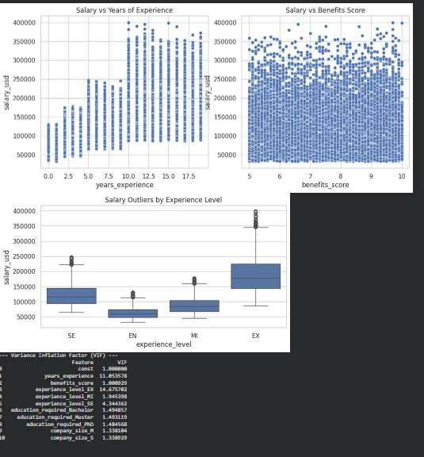
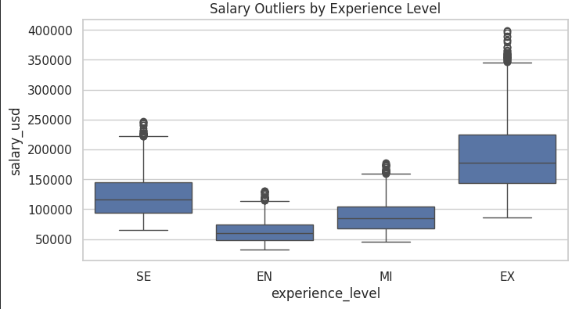

Slide 10
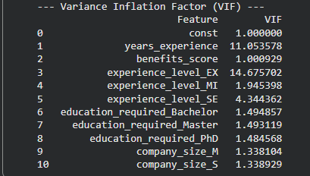
Multicollinearity Check Using VIF
Content
Variance Inflation Factor (VIF) was used to detect multicollinearity among predictors.
Interpretation of VIF:
VIF less than 5: Acceptable
VIF greater than 5: Moderate multicollinearity
VIF greater than 10: Serious multicollinearity
Justification
Multicollinearity can distort regression coefficients and reduce model reliability.

Slide 11
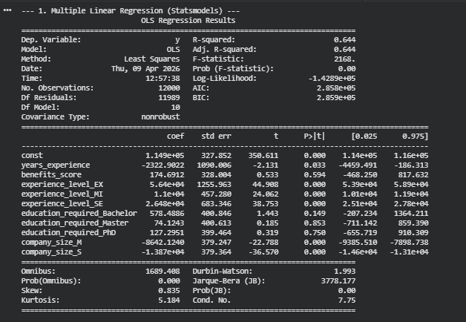

Multiple Linear Regression
Content
A multiple linear regression model was built using:
Years of experience
Benefits score
Experience level
Education requirement
Company size
Model Evaluation
R-squared value from OLS summary
Test Mean Squared Error (MSE)
Statistical significance using p-values
Justification
Linear regression helps identify how different factors influence salary.

Slide 12

KNN Regression
Content
A KNN regression model with k = 5 was used to predict salary.
Key Points
Uses nearby observations to predict salary
Sensitive to feature scaling
Standardization was necessary before applying KNN
Evaluation
Test MSE was calculated and compared with linear regression

Slide 13
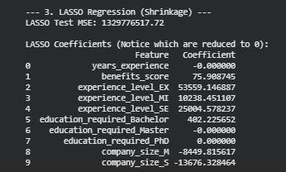
LASSO Regression
Content
LASSO regression was applied with alpha = 100.
Key Features
Performs variable selection
Shrinks some coefficients to zero
Helps reduce overfitting
Observations
Some predictors had coefficients equal to zero
Only important predictors remained in the model

Slide 14

Logistic Regression
Content
A logistic regression model was used to predict whether a job is fully remote.
Evaluation Metrics
Confusion Matrix
Accuracy Score
ROC Curve
Area Under Curve (AUC)
Justification
Logistic regression is appropriate for binary classification problems.

Slide 15


KNN Classification and Naive Bayes
Content
Two additional classification models were tested:
K-Nearest Neighbors Classification
Gaussian Naive Bayes
Evaluation
Accuracy scores were compared across models
Confusion matrix was generated for KNN classification
Justification
Comparing multiple models helps identify the best method for classification.

Slide 16
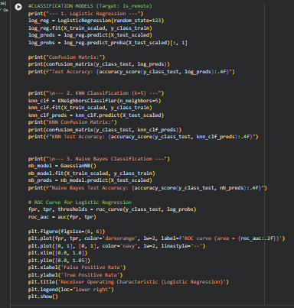
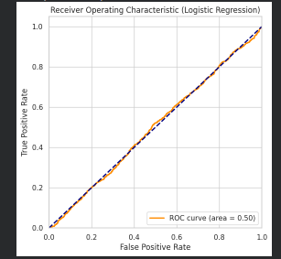

Slide 17
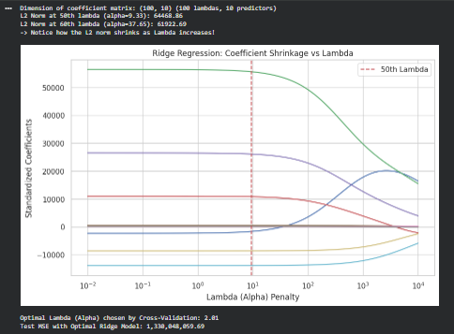
Ridge Regression
Content
Ridge regression was used to reduce
overfitting and coefficient instability.
Steps Performed
Generated 100 lambda values
Calculated coefficient shrinkage
Measured L2 norm of coefficients
Used cross-validation to find the
optimal lambda
Key Results
Optimal lambda value selected
Automatically.
Final Ridge model test MSE
calculated

Slide 18
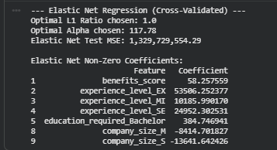
Elastic Net Regression
Content
Elastic Net combines Ridge and LASSO
penalties.
Advantages
Handles multicollinearity
Performs variable selection
Balances L1 and L2 penalties
Results
Optimal alpha selected
Optimal L1 ratio selected
Final test MSE calculated

Slide 19
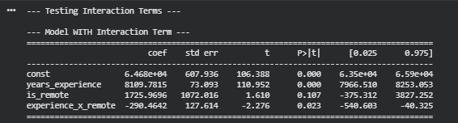
Interaction Effect Analysis
Content
An interaction term was created:
experience_x_remote = years_experience × is_remote
Two models were compared:
Model without interaction term
Model with interaction term
Purpose
To check whether the effect of experience on salary changes for remote jobs.

Slide 20
Influential Observations
Cook’s Distance and Influential Points
Content
Cook’s Distance was used to identify influential job postings.
Key Points
Threshold used: 4 / n
Observations above the threshold were considered influential
Influential points may strongly affect regression results

Slide 21
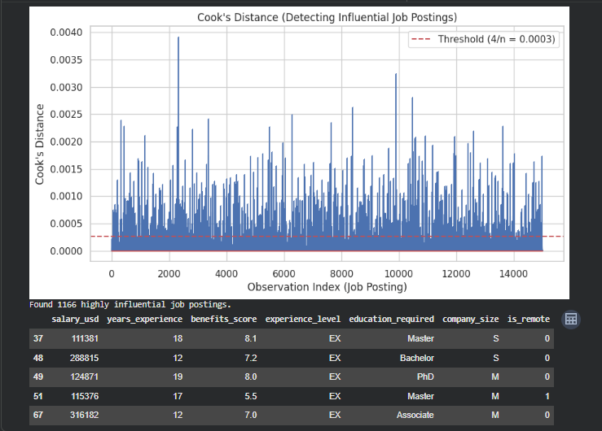

Slide 22
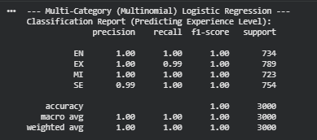
Multinomial Logistic Regression
Content
Multinomial logistic regression was used to predict experience level.
Predictors Used
Salary
Years of experience
Benefits score
Evaluation
Classification report
Precision
Recall
F1-score
Justification
This model is suitable when the target variable has more than two categories.

Slide 23
Simulation Study
Content
A simulation study was conducted with:
True intercept = 2
True slope = 3
1000 repetitions
Result
The average estimated coefficients were very close to the true population values.
Conclusion
Least Squares Estimators are unbiased.

Slide 24
Overall Model Comparison
Content
Regression Models Compared:
Multiple Linear Regression
KNN Regression
LASSO Regression
Ridge Regression
Elastic Net Regression
Classification Models Compared:
Logistic Regression
KNN Classification
Naive Bayes
Multinomial Logistic Regression

Slide 25
Key Findings
Years of experience is one of the strongest predictors of salary
Benefits score positively influences salary
Remote jobs can be predicted reasonably well using classification models
Ridge and Elastic Net improved model stability
LASSO helped identify the most important variables
Some influential observations were detected using Cook’s Distance

